Slide 1
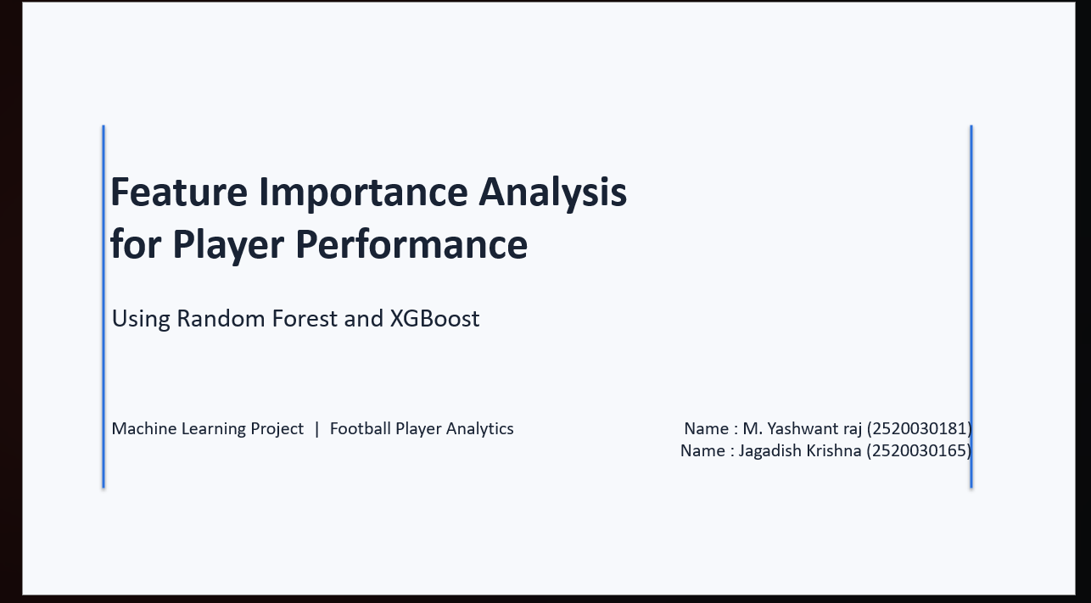

Slide 2
Abstract
Football player performance is influenced by many different statistical indicators.
This project explores how machine learning can be used to classify player performance and identify the factors that are most useful for distinguishing different performance levels.
The approach focuses on interpretable analysis, comparing two ensemble learning methods—Random Forest and XGBoost—to understand both prediction and the relative importance of player statistics.
2

Slide 3
Problem Statement
Football performance cannot be represented by a single statistic.
Different playing positions have different responsibilities, so the indicators of strong performance are not identical for forwards, midfielders, and defenders.
With a large number of available statistics, it is difficult to determine which factors are most useful for identifying performance levels.
The project addresses this challenge through machine-learning based performance classification and feature-importance analysis.
3

Slide 4
Exploratory Data Analysis (EDA)
Understanding the dataset before performance scoring and machine learning
RAW DATASET
92,170 × 120
rows × columns
POSITION FILTER
24,034
FW + MF + DF records
450-MIN FILTER
14,812
players retained
DUPLICATES FOUND
223
duplicate player-season groups
FINAL DATA
14,589
player-season records
EDA Findings
• 24,034 records remained after selecting 2017–18 to 2024–25 and FW/MF/DF positions.
• 223 duplicate player-season groups were identified and then combined; the final dataset has 14,589 unique player-season records.
• After the 450-minute filter, all score variables used for the performance score had 0 missing values.
4

Slide 5
Objectives
1. Understand Performance
Study the statistical indicators used to describe football player performance.
Consider the different roles of forwards, midfielders, and defenders.
2. Classify Performance
Organize players into meaningful performance levels such as Low, Medium, and High.
3. Compare ML Models
Compare Random Forest and XGBoost as ensemble learning approaches for performance classification.
4. Identify Important Factors
Determine which football statistics contribute most strongly to model-based performance predictions.
5

Slide 6
Why Random Forest?
Handles Many Features
Football performance involves many statistical variables. Random Forest can work effectively with a large set of numerical features.
Captures Nonlinear Patterns
Player statistics do not always have a simple linear relationship with performance. Decision trees can capture complex relationships.
Interpretable Comparison
Random Forest provides feature-importance information, making it useful when the goal is to understand which statistics influence predictions.
6

Slide 7
Why XGBoost?
Strong Predictive Power
XGBoost is a powerful gradient-boosting method designed to build accurate predictive models.
Learns from Errors
The model builds trees sequentially, allowing later trees to focus on correcting errors made by earlier trees.
Useful for Complex Data
It can model nonlinear relationships and interactions among football statistics, making it suitable for player-performance analysis.
7

Slide 8
Random Forest vs XGBoost
Random Forest
• Builds many decision trees
• Trees are combined to produce a final prediction
• Robust and relatively simple to interpret
• Provides feature-importance measures
• Good baseline ensemble method
XGBoost
• Uses gradient boosting
• Builds trees sequentially
• Later trees focus on previous errors
• Often achieves strong predictive performance
• Supports feature-importance analysis
8

Slide 9
Why This Analysis Matters
Position-Aware Evaluation
A forward, midfielder, and defender contribute to a team in different ways. Performance analysis should reflect those different responsibilities.
Data-Driven Decisions
Statistical analysis can support scouting, player comparison, recruitment, coaching, and performance evaluation.
Interpretability
Knowing which factors are important makes an ML system more useful than a model that only produces a prediction without explanation.
9

Slide 10
Conclusion & Future Scope
The project demonstrates how machine learning can support football player performance analysis.
Random Forest and XGBoost are suitable because they can model complex relationships among multiple player statistics while also providing information about important features.
Future work can extend the analysis with more leagues and seasons, richer match and tactical context, improved model tuning, and advanced explainability techniques such as SHAP.
10

